Slide 1
UNIT - I
Introduction
Disclaimer:
The lecture notes have been prepared by referring to many books and notes prepared by the teachers. This document does not claim any originality and cannot be used as a substitute for prescribed textbooks.

Slide 2
Topics
Introduction to Software Engineering
Software Project Management – Lifecycle Activities
Traditional – Waterfall, V Model, Prototype, Spiral, RAD
Conventional – Agile, XP, Scrum
Introduction to Requirements Engineering
Requirements Elicitation
Software Project Effort and Cost Estimation
Cocomo 1 and 2
Risk Management
Configuration Management
Project Planning – WBC, Planning, Scope, Risk

Slide 3
Introduction To Software Engineering
The IEEE definition:
Software Engineering: The application of a systematic, disciplined, quantifiable approach to the development, operation and maintenance of software.
Some realities:
To understand the problem before a software solution is developed
Design becomes a essential activity
Software should exhibit high quality
Software should be maintainable

Slide 4
Layered Technology
Software engineering is a layered technology.
The foundation for software engineering is the process layer.
Process defines a framework that must be established for effective delivery of software.
Software engineering methods provide the technical how-to’s for building software.
Methods encompass a broad array of tasks that include communication, requirements analysis, design modeling, program construction, testing, and support.
Software engineering tools provide automated or semi automated support for the process and the methods.
Tools
Methods
Process Model
“Quality” Focus

Slide 5
Essence of Practice
Polya suggests:
1. Understand the problem (communication and analysis).
2. Plan a solution (modeling and software design).
3. Carry out the plan (code generation).
4. Examine the result for accuracy (testing and quality assurance).
Understand the problem (Communication and Analysis)
- Who are the stakeholders?
- What are the unknowns?
- What data, functions, and features are required to properly solve the
problem?
- Can the problem be compartmentalized?
- Is it possible to represent smaller problems that may be easier to
understand?
- Can the problem be represented graphically?
- Can an analysis model be created?

Slide 6
Essence of Practice
Plan the Solution
- Have you seen similar problems before? Are there patterns that are familiar in a potential solution? Is there existing software that implements the data, functions, and features that are required?
- Has a similar problem been solved? If so, are elements of the solution reusable?
- Can sub problems be defined? If so, are solutions readily apparent for the sub problems?
- Can you represent a solution in a manner that leads to effective implementation? Can a design model be created? Can an analysis model be created?
Carry Out the Plan
- Does the solution conform to the plan? Is source code traceable to the design model?
- Is each component part of the solution provably correct? Has the design and code been reviewed, or better?

Slide 7
Essence of Practice
Examine the Result
- Is it possible to test each component part of the solution? Has a reasonable testing strategy been implemented?
- Does the solution produce results that conform to the data, functions, and features that are required? Has the software been validated against all stakeholder requirements?
How it all Starts – Safe Home:
Every software project is precipitated by some business need:
The need to correct a defect in an existing application;
The need to adapt a ‘legacy system’ to a changing business environment;
The need to extend the functions and features of an existing application, or
The need to create a new product, service, or system

Slide 8
Software Project Management
Introduction
Concerned with activities involved in ensuring that software is delivered on time and on schedule and in accordance with the requirements of the organisations developing and procuring the software.
Project management is needed because software development is always subject to budget and schedule constraints that are set by the organisation developing the software.
Success Criteria
Deliver the software to the customer at the agreed time.
Keep overall costs within budget.
Deliver software that meets the customer’s expectations.
Maintain a coherent and well-functioning development team.
Notes:
Coherent - Consistent

Slide 9
Software Project Management
Software Management Distinctions
The product is intangible.
Software cannot be seen or touched.
Software project managers cannot see progress by simply looking at the artefact that is being constructed.
Many software projects are 'one-off' projects.
Large software projects are usually different in some ways from previous projects.
Even managers who have lots of previous experience may find it difficult to anticipate problems.
Software processes are variable and organization specific.
We still cannot reliably predict when a particular software process is likely to lead to development problems.
Factors Influencing Project Management
Company size
Software customers

Slide 10
Software Project Management
Factors Influencing Project Management
Software size
Software type
Organizational culture
Software development processes
These factors mean that project managers in different organizations may work in quite different ways.
Software Management Lifecycle Activities
Proposal writing
The first stage in a software project may involve writing a proposal to win a contract to carry out an item of work.
The proposal describes the objectives of the project and how it will be carried out.
Project planning
Project managers are responsible for planning, estimating and scheduling project development and assigning people to tasks.

Slide 11
Software Project Management
Software Management Lifecycle Activities
Risk management
Project managers assess the risks that may affect a project, monitor these risks and take action when problems arise.
People management
Project managers have to choose people for their team and establish ways of working that leads to effective team performance.
Reporting
Project managers are usually responsible for reporting on the progress of a project to customers and to the managers of the company developing the software.

Slide 12
Traditional Software Process Models
Waterfall
It is the oldest paradigm for Software Engineering.
When requirements are well defined and reasonably stable, it leads to a linear fashion.
The waterfall model, sometimes called the classic life cycle, suggests a systematic, sequential approach to software development that begins with customer specification of requirements and progresses through planning, modeling, construction and deployment, culminating in ongoing support of the completed software.
When to select?
There are times when the requirements for a problem are well understood—when work flows from communication through deployment in a reasonably linear fashion.

Slide 13
Traditional Software Process Models
Waterfall - Problems
Inflexible partitioning of the project into distinct stages makes it difficult to respond to changing customer requirements.
Therefore, this model is only appropriate when the requirements are well-understood and changes will be fairly limited during the design process.
Few business systems have stable requirements.
The waterfall model is mostly used for large system engineering projects where a system is developed at several sites.
In those circumstances, the plan-driven nature of the waterfall model helps coordinate the work.
Waterfall - Advantages
Simple
Easy to understand even for non technical customers
Oldest, widely used
Base for all other models by including feed back loops, iterations etc.

Slide 14
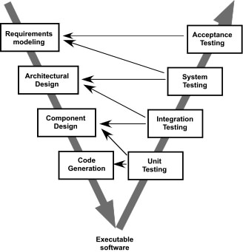
Traditional Software Process Models
Waterfall - Disadvantages
1. Real projects rarely follow this linear sequence.
2. Difficult for customer to state all requirements at one shot
3. Customer must have patience.
V-Model
A variation of waterfall model depicts
the relationship of quality assurance
actions to the actions associated with
communication, modeling and early code
construction activities.
Team first moves down the left side of
the V to refine the problem requirements.
Once code is generated, the team moves
up the right side of the V, performing
a series of tests that validate each of
the models created as the team moved
down the left side.

Slide 15
Traditional Software Process Models
Prototyping
Begins with communication
A quick plan for prototyping and modeling occur.
Quick design focuses on the representation of those aspects the software will be visible to end users. (Interface and output).
Design leads to the construction of
a prototype which will be deployed
and evaluated.
Stakeholder’s comments will be
used to refine requirements.
Quick
plan
Communication
Modeling
Quick design
Deployment
delivery &
feedback
Construction
of prototype

Slide 16
Traditional Software Process Models
Prototyping – When to Select
Customer defines a set of general objectives
Does not identify detailed requirements
Developer may be unsure of the efficiency of an algorithm, the form that human computer interaction should take.
When your customer has a legitimate need, but is clueless about the details, develop a prototype as a first step.
Prototyping - Advantages
1. Provides working model.
2. Customer is highly satisfied with such a modeling at initial stages
3. Developer gains business insight, reducing ambiguity
4. Great involvement of users
5. Reduce risks

Slide 17
Traditional Software Process Models
Prototyping - Disadvantages
1. Customer - not aware that only interface or appearance is concentrated much and long term quality is at stake.
2. False expectations from customer that end software modelling is finished or will have the same behavior/pace of the prototype.
3. Inappropriate choices of technology
4. Various iterations to a prototype that is to be discarded is expensive

Slide 18
Traditional Software Process Models
Spiral
It couples the iterative nature of prototyping with the controlled and systematic aspects of the waterfall model and is a risk-driven process model generator that is used to guide multi-stakeholder concurrent engineering of software intensive systems.
Two main distinguishing features: one is cyclic approach for incrementally growing a system’s degree of definition and implementation while decreasing its degree of risk. The other is a set of anchor point milestones for ensuring stakeholder commitment to feasible and mutually satisfactory system solutions.
A series of evolutionary releases are delivered.
During the early iterations, the release might be a model or prototype.
During later iterations, increasingly more complete version of the engineered system are produced.
The first circuit in the clockwise direction might result in the product specification; subsequent passes around the spiral might be used to develop a prototype and then progressively more sophisticated versions of the software.
Each pass results in adjustments to the project plan.
Cost and schedule are adjusted based on feedback.

Slide 19
Traditional Software Process Models
Spiral
Also, the number of iterations will be adjusted by project manager.
Good to develop large-scale system as software evolves as the process progresses and risk should be understood and properly reacted to.
Prototyping is used to reduce risk.
However, it may be difficult to convince customers that it is controllable as it demands considerable risk assessment expertise.

Slide 20
Traditional Software Process Models
Spiral - Advantages
1. Applies throughout lifecycle
Concept Development
New Product Development
Product Enhancement
2. Risk is considered at each pass
3. Uses prototyping as risk reduction mechanism
4. Customer and developer understand and better react to risks
Spiral - Disadvantages
1. Difficult to convince customers that it is controllable
2. Demands considerable risk assessment expertise
3. Major risk is not uncovered/managed, problem will occur

Slide 21
Traditional Software Process Models
Rapid Application Development
An approach to software development aimed at rapid delivery of the software.
It often involves the use of database programming and development support tools such as screen and report generators.
There are three broad phases to RAD:
Requirements planning
RAD design workshop
Implementation
Requirements planning
- Users and analysts meet to identify objectives of the application or system
- Oriented toward solving business problems
RAD Design Workshop
Design and refine phase
Use group decision support systems to help users agree on designs
Programmers and analysts can build and show visual representations of the designs and workflow to users

Slide 22
Traditional Software Process Models
Rapid Application Development
RAD Design Workshop
Users respond to actual working prototypes
Analysts refine designed modules based on user responses
Implementation Phase
- As the systems are built and refined, the new systems or partial systems are tested and introduced to the organization
- When creating new systems, there is no need to run old systems in parallel
The Martin approach to RAD includes four phases:
Requirements planning
User design
Construction
Cutover

Slide 23
Traditional Software Process Models
Rapid Application Development – When to Select
The team includes programmers and analysts who are experienced with it
There are pressing reasons for speeding up application development
The project involves a novel ecommerce application and needs quick results
Users are sophisticated and highly engaged with the goals of the company
Rapid Application Development – Advantages
RAD is very powerful when used within the SDLC
It can be used as a tool to update, improve or innovate selected portions of the system
Rapid Application Development – Disadvantages
May try and hurry the project too much
Loosely documented
May not address pressing business problems
Potentially steep learning curve for programmers inexperienced with RAD tools

Slide 24
Conventional Software Process Models
Agile
Agile software development is a group of software development methods in which requirements and solutions evolve through collaboration between self-organizing, cross-functional teams.
It promotes adaptive planning, evolutionary development, early delivery, continuous improvement, and encourages rapid and flexible response to change.
What is Agility?
Effective (rapid and adaptive) response to change
Effective communication among all stakeholders
Drawing the customer onto the team
Organizing a team so that it is in control of the work performed
Yielding …Rapid, incremental delivery of software
Agile Process is driven by customer descriptions of what is required (scenarios)
Recognizes that plans are short-lived
Develops software iteratively with a heavy emphasis on construction activities
Delivers multiple ‘software increments’
Adapts as changes occur

Slide 25
Conventional Software Process Models
Agile - Principles
1. Our highest priority is to satisfy the customer through early and continuous delivery of valuable software.
2. Welcome changing requirements, even late in development. Agile processes harness change for the customer's competitive advantage.
3. Deliver working software frequently, from a couple of weeks to a couple of months, with a preference to the shorter timescale.
4. Business people and developers must work together daily throughout the project.
5. Build projects around motivated individuals. Give them the environment and support they need, and trust them to get the job done.
6. The most efficient and effective method of conveying information to and within a development team is face–to–face conversation.
7. Working software is the primary measure of progress.
8. Agile processes promote sustainable development. The sponsors, developers, and users should be able to maintain a constant pace indefinitely.
9. Continuous attention to technical excellence and good design enhances agility.
10. Simplicity – the art of maximizing the amount of work not done – is essential.

Slide 26
Conventional Software Process Models
Agile – Principles
11. The best architectures, requirements, and designs emerge from self–organizing teams.
12. At regular intervals, the team reflects on how to become more effective, then tunes and adjusts its behavior accordingly.
Human Factors
The process moulds to the needs of the people and team, not the other way around
Key traits must exist among the people on an agile team and the team itself:
Competence
Common focus
Collaboration
Decision-making ability
Fuzzy problem-solving ability
Mutual trust and respect
Self-organization

Slide 27
Conventional Software Process Models
Agile – Extreme Programming (XP)
The most widely used agile process, originally proposed by Kent Beck
XP Planning
Begins with the creation of “user stories (Listening leads to creation of set of “stories” (also called user stories) that describe required output, features and functionality for software to be built).”
Agile team assesses each story and assigns a cost
Stories are grouped, for a deliverable increment
A commitment is made on delivery date
After the first increment “project velocity” is used to help define subsequent delivery dates for other increments
XP Design
Follows the KIS principle
Encourage the use of CRC cards
For difficult design problems, suggests the creation of “spike solutions”—a design prototype
Encourages “refactoring”—an iterative refinement of the internal program design
Notes:
Class-Responsibility-Collaboration

Slide 28
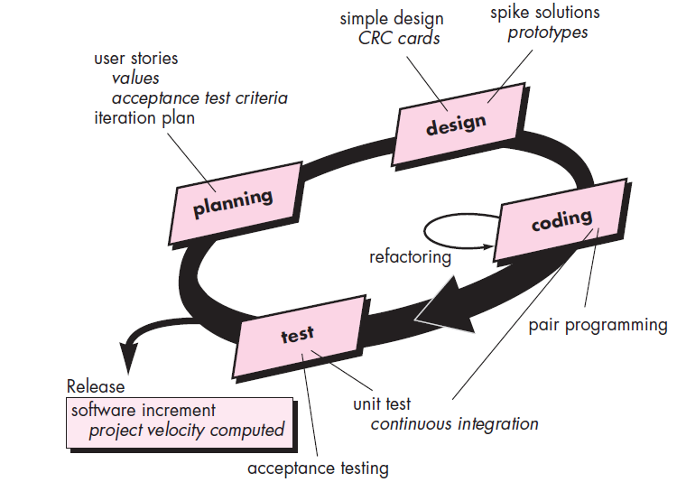
Conventional Software Process Models
Agile – Extreme Programming (XP)

Slide 29
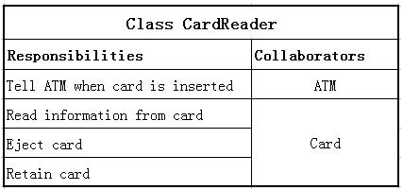
Conventional Software Process Models
Agile – Extreme Programming (XP)
XP Coding
Recommends the construction of a unit test for a store before coding commences
Encourages “pair programming” (XP recommends that two people work together at one computer workstation to create code for a story)
XP Testing
All unit tests are executed daily
“Acceptance tests” are defined by the customer and executed to assess customer visible functionality

Slide 30
Conventional Software Process Models
Agile – Scrum
Scrum is an agile software development method that was conceived by Jeff Sutherland and his development team in the early 1990s.
In recent years, further development on the scrum methods has been performed by Schwaber and Beedle.
Scrum principles are consistent with the agile manifesto and are used to guide development activities within a process that incorporates the following framework activities: Requirements, Analysis, Design, Evolution and delivery.
Within each framework activity, work tasks occur within a process pattern called a sprint.
The work conducted within a sprint is adapted to the problem at hand and is defined and often modified in real time by the Scrum team.
The overall flow of the Scrum process is illustrated in figure below.
Scrum emphasizes the use of a set of software process patterns that have proven effective for projects with tight timelines, changing requirements and business criticality.
Each of these process patterns defines a set of development actions:
1. Backlog – a prioritized list of project managements or features that provide business value for the customer. Items can be added to the backlog at any time. The product manager assess the backlog and updates priorities as required.

Slide 31
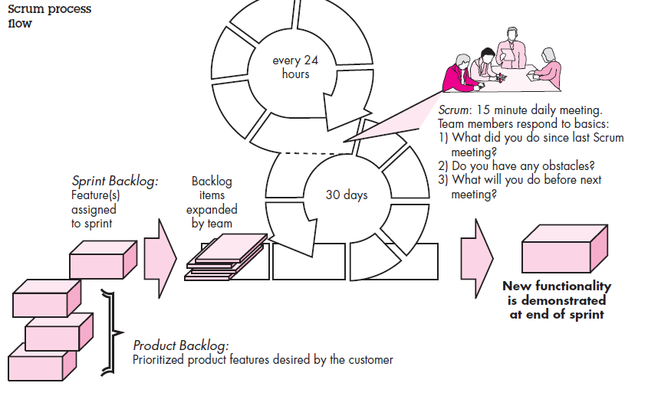
Conventional Software Process Models
Agile – Scrum

Slide 32
Conventional Software Process Models
Agile – Scrum
Each of these process patterns defines a set of development actions:
2. Sprints – consist of work units that are required to achieve a requirement defined in the backlog that must be fit into a predefined time-box (typically 30 days). Changes (e.g., backlog work items) are not introduced during the sprint. Hence, the sprint allows team members to work in a short term, but stable environment.
3. Scrum meetings – are short (typically 15 minutes) meetings held daily by the Scrum team. Three key questions are asked and answered by all team members:
a. What did you do since the last team meeting?
b. What obstacles are you encountering?
c. What do you plan to accomplish by the next team meeting?
A team leader, called a Scrum master, leads the meeting and assesses the responses from each person.
The Scrum meeting helps the team to uncover potential problems as early as possible.
Also, these daily meetings lead to “knowledge socialization” and thereby promote a self-organizing team structure.

Slide 33
Conventional Software Process Models
Agile – Scrum
Demos – deliver the software increment to the customer so that functionality that has been implemented can be demonstrated and evaluated by the customer.
It is important to note that the demo may not contain all planned functionality, but rather those functions that can be delivered within the time-box that was established.
Beedle and his colleagues present a comprehensive discussion of these patterns in which they state: “Scrum assumes up-front the existence of chaos…”
The Scrum process patterns enable a software team to work successfully in a world where the elimination of uncertainty is impossible.

Slide 34
Introduction to Requirement Engineering
Inception—ask a set of questions that establish …
Basic understanding of the problem
The people who want a solution
The nature of the solution that is desired, and
The effectiveness of preliminary communication and collaboration between the customer and the developer
Elicitation—elicit requirements from all stakeholders
Elaboration—create an analysis model that identifies data, function and behavioral requirements
Negotiation—agree on a deliverable system that is realistic for developers and customers
Specification—can be any one (or more) of the following:
A written document
A set of models
A formal mathematical
A collection of user scenarios (use-cases)
A prototype

Slide 35
Introduction to Requirement Engineering
Validation—a review mechanism that looks for
errors in content or interpretation
areas where clarification may be required
missing information
inconsistencies (a major problem when large products or systems are engineered)
conflicting or unrealistic (unachievable) requirements.
Requirements management
Inception
Identify stakeholders
“who else do you think I should talk to?”
Recognize multiple points of view
Work toward collaboration
The first questions
Who is behind the request for this work?
Who will use the solution?
What will be the economic benefit of a successful solution?
Is there another source for the solution that you need?

Slide 36
Requirements Elicitation
Meetings are conducted and attended by both software engineers and customers.
Rules for preparation and participation are established
An agenda is suggested
A "facilitator" (can be a customer, a developer, or an outsider) controls the meeting.
A "definition mechanism" (can be work sheets, flip charts, or wall stickers or an electronic bulletin board, chat room or virtual forum) is used.
The goal is
To identify the problem
Propose elements of the solution
Negotiate different approaches, and
Specify a preliminary set of solution requirements

Slide 37
Requirements Elicitation

Slide 38
Quality Function Deployment
Function deployment determines the “value” (as perceived by the customer) of each function required of the system
Information deployment identifies data objects and events
Task deployment examines the behavior of the system
Value analysis determines the relative priority of requirements

Slide 39
Elicitation Work Products
A statement of need and feasibility.
A bounded statement of scope for the system or product.
A list of customers, users, and other stakeholders who participated in requirements elicitation.
A description of the system’s technical environment.
A list of requirements (preferably organized by function) and the domain constraints that apply to each.
A set of usage scenarios that provide insight into the use of the system or product under different operating conditions.
Any prototypes developed to better define requirements.

Slide 40
Building Analysis Model
Elements of the analysis model
Scenario-based elements
Functional—processing narratives for software functions
Use-case—descriptions of the interaction between an “actor” and the system
Class-based elements
Implied by scenarios
Behavioral elements
State diagram
Flow-oriented elements
Data flow diagram

Slide 41
Scenario-based Elements - Use Cases
A collection of user scenarios that describe the thread of usage of a system.
Each scenario is described from the point-of-view of an “actor”—a person or device that interacts with the software in some way.
Each scenario answers the following questions:
Who is the primary actor, the secondary actor(s)?
What are the actor’s goals?
What preconditions should exist before the story begins?
What main tasks or functions are performed by the actor?
What extensions might be considered as the story is described?
What variations in the actor’s interaction are possible?
What system information will the actor acquire, produce, or change?
Will the actor have to inform the system about changes in the external environment?
What information does the actor desire from the system?
Does the actor wish to be informed about unexpected changes?

Slide 42
Use Case Diagram

Slide 43
Class-based Elements - Class Diagram
Each usage scenario implies a set of objects that are manipulated as an actor interacts with the system.
These objects are categorized into classes – a collection of things that have similar attributes and common behaviors.
For example, a UML class diagram can be used to depict a Sensor class for the SafeHome security function.
Note that the diagram lists the attributes of sensors (name, type) and the operations (e.g., identify, enable) that can be applied to modify these attributes.
In addition to class diagrams, other analysis modeling elements depict the manner in which classes collaborate with one another and the relationships and interactions between classes.
From the SafeHome system …

Slide 44
Behavioral Elements - State Diagram
The behavior of a computer-based system can have a profound effect on the design that is chosen and the implementation approach that is applied.
Therefore, the requirements model must provide modeling elements that depict behavior.
The state diagram is one method for representing the behavior of a system by depicting its states and the events that cause the system to change state.
A state is any externally observable mode of behavior.
In addition, the state diagram indicates actions (process activation) taken as a consequence of a particular event.
To illustrate the use of a state diagram, consider software embedded within the SafeHome control panel that is responsible for reading user input.
A simplified UML state diagram is shown.
Reading
Commands
State name
System status = “ready”
Display msg = “enter cmd”
Display status = steady
State variables
Entry/subsystems ready
Do: poll user input panel
Do: read user input
Do: interpret user input
State activities

Slide 45
Flow-Oriented Elements
Information is transformed as it flows through a computer-based system.
The system accepts input in a variety of forms, applies functions to transform it and produces output in a variety of forms.
Input may be a control signal transmitted by a transducer, a series of numbers typed by a human operator, a packet of information transmitted on a network link, or a voluminous data file retrieved from secondary storage.
The transform(s) may comprise a single logical comparison, a complex numerical algorithm, or a rule-inference approach of an expert system.
Output may light a single LED or produce a 200-page report.
In effect, we can create a flow model for any computer-based system, regardless of size and complexity.

Slide 46
Analysis Patterns
Pattern name: A descriptor that captures the essence of the pattern.
Intent: Describes what the pattern accomplishes or represents
Motivation: A scenario that illustrates how the pattern can be used to address the problem.
Forces and context: A description of external issues (forces) that can affect how the pattern is used and also the external issues that will be resolved when the pattern is applied.
Solution: A description of how the pattern is applied to solve the problem with an emphasis on structural and behavioral issues.
Consequences: Addresses what happens when the pattern is applied and what trade-offs exist during its application.
Design: Discusses how the analysis pattern can be achieved through the use of known design patterns.
Known uses: Examples of uses within actual systems.
Related patterns: One or more analysis patterns that are related to the named pattern because (1) it is commonly used with the named pattern;
(2) it is structurally similar to the named pattern;
(3) it is a variation of the named pattern.

Slide 47
Negotiating Requirements
Identify the key stakeholders
These are the people who will be involved in the negotiation
Determine each of the stakeholders “win conditions”
Win conditions are not always obvious
Negotiate
Work toward a set of requirements that lead to “win-win”

Slide 48
Validating Requirements
Is each requirement consistent with the overall objective for the system/product?
Have all requirements been specified at the proper level of abstraction? That is, do some requirements provide a level of technical detail that is inappropriate at this stage?
Is the requirement really necessary or does it represent an add-on feature that may not be essential to the objective of the system?
Is each requirement bounded and unambiguous?
Does each requirement have attribution? That is, is a source (generally, a specific individual) noted for each requirement?
Do any requirements conflict with other requirements?

Slide 49
Validating Requirements
Is each requirement achievable in the technical environment that will house the system or product?
Is each requirement testable, once implemented?
Does the requirements model properly reflect the information, function and behavior of the system to be built.
Has the requirements model been “partitioned” in a way that exposes progressively more detailed information about the system.
Have requirements patterns been used to simplify the requirements model.
Have all patterns been properly validated? Are all patterns consistent with customer requirements?

Slide 50
Software Project Effort and Cost Estimation
Software projects are inherently effort driven because most of work involves human effort to build the software product.
Estimating the effort required to build the software product is difficult as the result of effort is intangible and difficult to make effort estimation in building software artifacts.
There are many techniques like Function point analysis, wide band Delphi, COCOMO etc. for making effort estimation on software projects.
Depending on requirement, a suitable effort estimation technique is chosen for any software project.
Since effort estimation techniques are not foolproof, effort estimates need to be revised as the project progresses.
Once effort estimates are made for the project, cost estimates are calculated based on the effort estimate and cost parameters like hourly salary of individual employees.
Cost estimates are done using techniques like activity based costing or cost factor analysis.

Slide 51
Software Project Effort and Cost Estimation
Estimation of resources, cost, and schedule for a software engineering effort requires
Experience
Access to good historical information (metrics)
The courage to commit to quantitative predictions when qualitative information is all that exists
Estimation carries inherent risk and this risk leads to uncertainty.
Project scope must be understood
Elaboration (decomposition) is necessary
Historical metrics are very helpful
At least two different techniques should be used
Uncertainty is inherent in the process
Estimation Techniques:
Past (similar) project experience
Conventional estimation techniques
Task breakdown and effort estimates
Size (e.g., FP) estimates
Empirical models
Automated tools

Slide 52
Software Project Effort and Cost Estimation
Software projects use different kinds of software development life cycle models like waterfall model, iterative model etc.
Effort estimation for each type of software development lifecycle model requires understanding the difference in the way the software product is built.
In iterative models, software products are built in small incremental cycles.
On the contrary in the waterfall model, software products are built in one go and thus all product features are fully built in the same one cycle.
This fundamental difference necessitates a different approach to effort estimation for each type of software development lifecycle model projects.
Software products are made manually by software engineers.
How many of these people are needed on the project and for how long, is determined by the effort estimate and project duration.
Resource estimation also needs to take into consideration the skill set required on the project.
Of course, speed with which a software engineer can build a software product varies and thus this factor can affect resource estimation on the project.

Slide 53
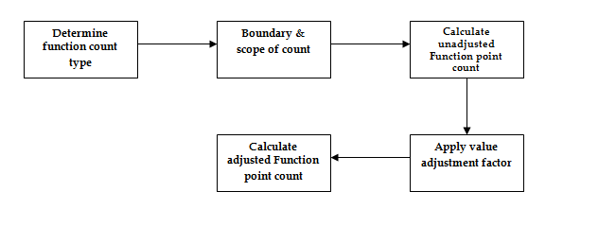
Software Project Effort and Cost Estimation
Function point count for effort estimate (function point analysis technique)
Function points are derived using an empirical relationship based on countable (direct) measures of software’s information domain and qualitative assessments of software complexity.
The function point (FP) metric can be used effectively as a means for measuring the functionality delivered by a system.
Using historical data, the FP metric can then be used to – a) estimate the cost or effort required to design, code and test the software, b) predict the number of errors that will be encountered during testing, c) forecast the number of components and/or the number of projected source lines in the implemented system.

Slide 54
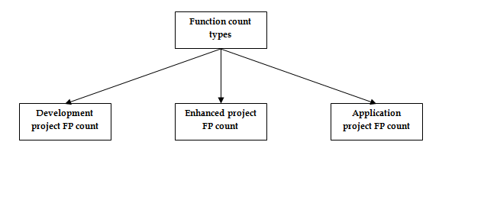
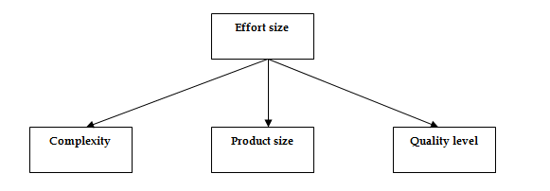
Software Project Effort and Cost Estimation
Function count type for effort estimate (function point analysis technique)
Effort sizing for effort estimate (function point analysis technique)

Slide 55
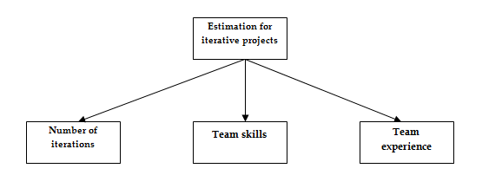
Software Project Effort and Cost Estimation
Effort estimate for iterative projects

Slide 56
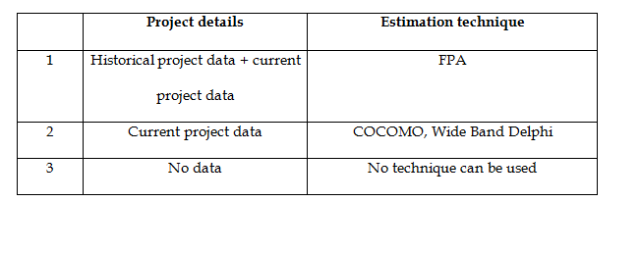
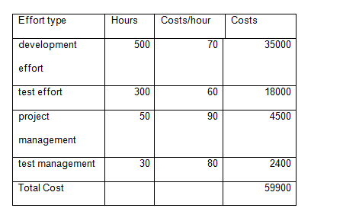
Software Project Effort and Cost Estimation
Comparison of effort estimate techniques
Effort and cost for various project tasks

Slide 57
Software Pricing
Estimates are made to discover the cost, to the developer, of producing a software system.
You take into account, hardware, software, travel, training and effort costs.
There is not a simple relationship between the development cost and the price charged to the customer.
Broader organisational, economic, political and business considerations influence the price charged.
Factors affecting Software Pricing
Factor | Description
Contractual terms | A customer may be willing to allow the developer to retain ownership of the source code and reuse it in other projects. The price charged may then be less than if the software source code is handed over to the customer.
Cost estimate uncertainty | If an organization is unsure of its cost estimate, it may increase its price by a contingency over and above its normal profit.
Financial health | Developers in financial difficulty may lower their price to gain a contract. It is better to make a smaller than normal profit or break even than to go out of business. Cash flow is more important than profit in difficult economic times.

Slide 58
Software Pricing
Factors affecting Software Pricing
Pricing Strategies
Under pricing
A company may under price a system in order to gain a contract that allows them to retain staff for future opportunities
A company may under price a system to gain access to a new market area
Increased pricing
The price may be increased when a buyer wishes a fixed-price contract and so the seller increases the price to allow for unexpected risks
Factor | Description
Market opportunity | A development organization may quote a low price because it wishes to move into a new segment of the software market. Accepting a low profit on one project may give the organization the opportunity to make a greater profit later. The experience gained may also help it develop new products.
Requirements volatility | If the requirements are likely to change, an organization may lower its price to win a contract. After the contract is awarded, high prices can be charged for changes to the requirements.

Slide 59
Pricing to Win
The software is priced according to what the software developer believes the buyer is willing to pay.
If this is less that the development costs, the software functionality may be reduced accordingly with a view to extra functionality being added in a later release.
Additional costs may be added as the requirements change and these may be priced at a higher level to make up the shortfall in the original price.

Slide 60
Software Project Effort and Cost Estimation
Project Planning – Task Set
Estimate cost and effort
Decompose the problem
Develop two or more estimates using size, function points, process tasks or use-cases
Reconcile the estimates
Develop a project schedule
Establish a meaningful task set
Define a task network
Use scheduling tools to develop a timeline chart
Define schedule tracking mechanisms

Slide 61
Software Project Effort and Cost Estimation – Software Sizing
Predicated on …
The degree to which the planner has properly estimated the size of the product to be built
The ability to translate the size estimate into human effort, calendar time, and dollars (a function of the availability of reliable software metrics from past projects)
The degree to which the project plan reflects the abilities of the software team
The stability of product requirements and the environment that supports the software engineering effort.

Slide 62
Functional Decomposition
Software Project Effort and Cost Estimation - Techniques
Statement
of
Scope
Functional
decomposition
Perform a Grammatical “parse”

Slide 63
Conventional Methods – LOC/FP Approach
Software Project Effort and Cost Estimation - Techniques
Compute LOC/FP using estimates of information domain values
Use historical data to build estimates for the project
Example – LOC Approach
Average productivity for systems of this type = 620 LOC/pm.
Burdened labor rate =$8000 per month, the cost per line of code is approximately $13.
Based on the LOC estimate and the historical productivity data, the total estimated project cost is $431,000 and the estimated effort is 54 person-months.

Slide 64
Example: FP Approach
Software Project Effort and Cost Estimation - Techniques
Conventional Methods – LOC/FP Approach
The estimated number of FP is derived:
FP_{estimated} = count-total 3 [0.65 + 0.01 3 S (F_{i})]
FP_{estimated} = 375
organizational average productivity = 6.5 FP/pm.
burdened labor rate = $8000 per month, approximately $1230/FP.
Based on the FP estimate and the historical productivity data, total estimated project cost is $461,000 and estimated effort is 58 person-months.

Slide 65
Software Project Effort and Cost Estimation - Techniques
Process Based Estimation
Obtained from “process framework”
Framework activities
Application
functions
Effort required to accomplish
each framework activity for each application function

Slide 66
Software Project Effort and Cost Estimation - Techniques
Process Based Estimation - Example
Based on an average burdened labor rate of $8,000 per month, the total estimated project cost is $368,000 and the estimated effort is 46 person-months.

Slide 67
Software Project Effort and Cost Estimation - Techniques
Tool Based Estimation
Project Characteristics
Calibration Factors
LOC/FP data

Slide 68
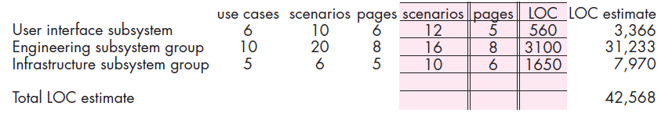
Software Project Effort and Cost Estimation - Techniques
Estimation with Use Cases
Using 620 LOC/pm as the average productivity for systems of this type and a burdened labor rate of $8000 per month, the cost per line of code is approximately $13. Based on the use-case estimate and the historical productivity data, the total estimated project cost is $552,000 and the estimated effort is 68 person-months.

Slide 69
Software Project Effort and Cost Estimation - Problems
Estimated LOC count is 56,100 . Assuming that your organization produces 450 LOC/pm with a burdened labor rate of $7000 per person-month, find the cost /LOC, total estimated project cost and estimated effort in person months.
To Compute:
Cost per LOC = Labor rate per month/LOC per pm
Total Estimated Project Cost = Estimated LOC * Cost per LOC
Estimated Effort in pm = Total Estimated Project Cost/ Labor rate per month
Notes:
1)15.5, 2)869550, 3)124

Slide 70
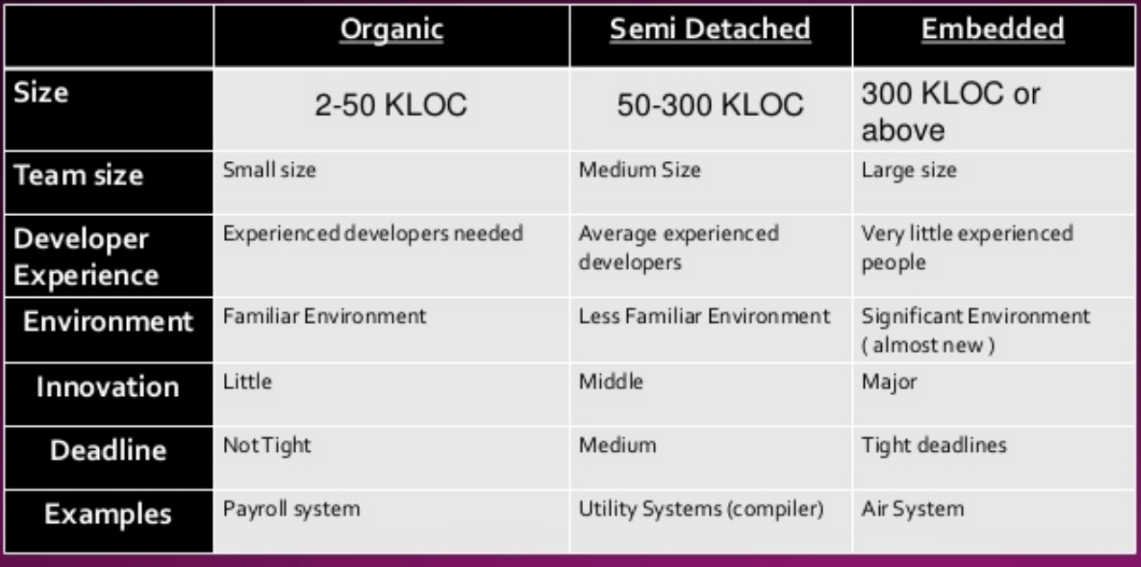
COCOMO I
The constructive cost model was developed by Barry W. Boehm in the late 1970s and published in Boehm's 1981 as a model for estimating effort, cost and schedule for software projects.
Basic model - It estimates the software in a rough and quick manner.
Mostly used in small and medium sized projects.
3 modes of development:
a) Organic,
b) Semi Detached,
c) Embedded

Slide 71
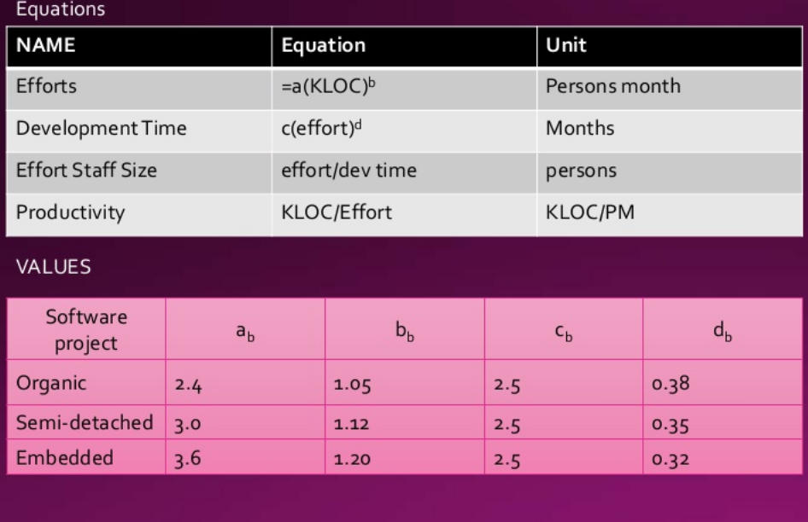
COCOMO - I
Equation & Example

Slide 72
COCOMO I
Numerical
Suppose a project was estimated to be 400 KLOC. Calculate effort and time for organic mode.
Organic:
Effort = a (KLOC)^{b}
Effort = 2.4 (400)^{1.05}
Effort = 1295PM
Development Time = c (Effort)^{d}
Development Time = 2.5 (1295)^{0.38}
Development Time = 38 Months, Find Effort Staff Size, Productivity??
Semi-detached:
Effort = a (KLOC)^{b}
Effort = 3.0 (400)^{1.12}
Person Months = 2462PM, Find Development Time, Effort Staff Size, Productivity??
Embedded:
Effort = a (KLOC)^{b}
Effort = 3.6 (400)^{1.20}
Person Months = 4772PM , Find Development Time , Effort Staff Size, Productivity??
Notes:
Organic=34, 0.30; Semi Detached, Development Time=2.5(2462)^0.35=38, 65, 0.16 ; Embedded, Development Time=2.5(4772)^0.32=37, 129, 0.08

Slide 73
COCOMO II
Barry Boehm introduced a hierarchy of software estimation models bearing the name COCOMO, for Constructive Cost Model.
The original COCOMO model became one of the most widely used and discussed software cost estimation models in the industry.
It has evolved into a more comprehensive estimation model, called COCOMO II.
Like its predecessor, COCOMO II is actually a hierarchy of estimation models that address the following areas:
Application composition model: Used during the early stages of software engineering, when prototyping of user interfaces, consideration of software and system interaction, assessment of performance, and evaluation of technology maturity are paramount.
Early design stage model: Used once requirements have been stabilized and basic software architecture has been established.
Post-architecture-stage model: Used during the construction of the software.
Like all estimation models for software, the COCOMO II models require sizing information.
Three different sizing options are available as part of the model hierarchy: object points, function points and lines of source code.

Slide 74
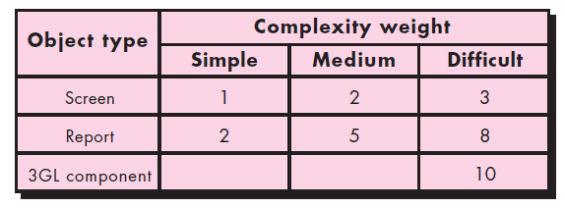
COCOMO II
The COCOMO II application composition model uses object points and is illustrated below.
It should be noted that other, more sophisticated estimation models (using FP and KLOC) are also available as part of COCOMO II.
Complexity weighting for object types
Like function points, the object point is an indirect software measure that is computed using counts of the number of (a) screens (at the user interface), (b) reports, and (c) components likely to be required to build the application.
Each object instance (e.g., a screen or report) is classified into one of three complexity levels (i.e., simple, medium, or difficult) using criteria suggested by Boehm.
In essence, complexity is a function of the number and source of the client and server data tables that are required to generate the screen or report and the number of views or sections presented as part of the screen or report.

Slide 75
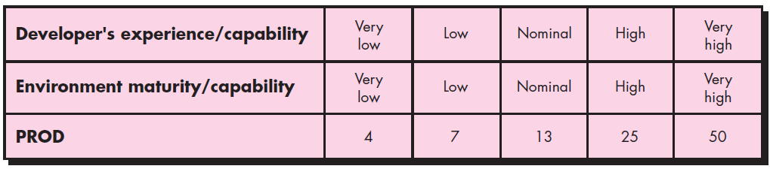
COCOMO II
Once complexity is determined, the number of screens, reports and components are weighted according to the table illustrated in above figure.
The object point count is then determined by multiplying the original number of object instances by the weighting factor in the figure and summing to obtain a total object point count.
When component-based development or general software reuse is to be applied, the percent of reuse (%reuse) is estimated and the object point count is adjusted:
NOP = (object points) * [(100 - % reuse) / 100], where NOP is defined as new object points
To derive an estimate of effort based on the computed NOP value, a “productivity rate” must be derived.

Slide 76
COCOMO II
The figure above presents the productivity rate,
PROD = NOP / person-month, for different levels of developer experience and development environment maturity.
Once the productivity rate has been determined, an estimate of project effort is computing using,
Estimated effort = NOP / PROD
In more advanced COCOMO II models (these models use FP and KLOC counts of the size variable), a variety of scale factors, cost drivers, and adjustment procedures are required.

Slide 77
COCOMO II - Problems
Use the COCOMO II model to estimate the effort required to build software for a simple ATM that produces 12 screens, 10 reports, and will require approximately 80 software components, Percentage of reuse is 20%, Value of Prod=9. Use the application composition model with object points.
To Compute:
Object points = screen + report + components
NOP = Object Points * [(100 - % reuse)/100]
Estimated Effort = NOP/PROD
Notes:
1)102, 2)81.6, 3)9

Slide 78
Risk Management
Introduction
A risk is a potential problem – it might happen or it might not
Conceptual definition of risk
Risk concerns future happenings
Risk involves change in mind, opinion, actions, places, etc.
Risk involves choice and the uncertainty that choice entails
Two characteristics of risk
Uncertainty – the risk may or may not happen, that is, there are no 100% risks. (those, instead are called constraints)
Loss – the risk becomes a reality and unwanted consequences or losses occur

Slide 79
Risk Management
Risk Categorization – Approach #1
Project risks
They threaten the project plan
If they become real, it is likely that the project schedule will slip and that costs will increase
Technical risks
They threaten the quality and timeliness of the software to be produced
If they become real, implementation may become difficult or impossible
Business risks
They threaten the viability of the software to be built
If they become real, they jeopardize the project or the product
Sub-categories of Business risks
Market risk – building an excellent product or system that no one really wants
Strategic risk – building a product that no longer fits into the overall business strategy for the company
Sales risk – building a product that the sales force doesn't understand how to sell
Management risk – losing the support of senior management due to a change in focus or a change in people
Budget risk – losing budgetary or personnel commitment

Slide 80
Risk Management
Risk Categorization – Approach #2
Known risks
Those risks that can be uncovered after careful evaluation of the project plan, the business and technical environment in which the project is being developed, and other reliable information sources (e.g., unrealistic delivery date).
Predictable risks
Those risks that are extrapolated from past project experience (e.g., past
turnover).
Unpredictable risks
Those risks that can and do occur, but are extremely difficult to identify in advance.

Slide 81
Risk Strategies
Reactive risk strategies
"Don't worry, I'll think of something"
The majority of software teams and managers rely on this approach
Nothing is done about risks until something goes wrong
The team then flies into action in an attempt to correct the problem rapidly
(Fire fighting)
Crisis management is the choice of management techniques
Proactive risk strategies
Steps for risk management are followed (see next slide)
Primary objective is to avoid risk and to have a contingency plan in place to handle unavoidable risks in a controlled and effective manner

Slide 82
Steps for Risk Management
Identify possible risks; recognize what can go wrong.
Analyze each risk to estimate the probability that it will occur and the impact (i.e., damage) that it will do if it does occur.
Rank the risks by probability and impact
- Impact may be negligible, marginal, critical, and catastrophic
Develop a contingency plan to manage those risks having high probability and high impact.

Slide 83
Risk Identification
Background
Risk identification is a systematic attempt to specify threats to the project plan
By identifying known and predictable risks, the project manager takes a first
step toward avoiding them when possible and controlling them when
necessary
Generic risks
Risks that are a potential threat to every software project
Product-specific risks
Risks that can be identified only by those a with a clear understanding of the technology, the people, and the environment that is specific to the software that is to be built
This requires examination of the project plan and the statement of scope
"What special characteristics of this product may threaten our project plan?“

Slide 84
Risk Item Checklist
Used as one way to identify risks
Focuses on known and predictable risks in specific subcategories (see next slide)
Can be organized in several ways
A list of characteristics relevant to each risk subcategory
Questionnaire that leads to an estimate on the impact of each risk
A list containing a set of risk component and drivers along with their probability of occurrence

Slide 85
Known & Predictable Risk Categories
Product size – risks associated with overall size of the software to be built
Business impact – risks associated with constraints imposed by management or the marketplace
Customer characteristics – risks associated with sophistication of the customer and the developer's ability to communicate with the customer in a timely manner
Process definition – risks associated with the degree to which the software process has been defined and is followed
Development environment – risks associated with availability and quality of the tools to be used to build the project
Technology to be built – risks associated with complexity of the system to be built and the "newness" of the technology in the system
Staff size and experience – risks associated with overall technical and project experience of the software engineers who will do the work

Slide 86
Questionnaire on Project Risk
(Questions are ordered by their relative importance to project success)
Have top software and customer managers formally committed to support the project?
Are end-users enthusiastically committed to the project and the system/product to be built?
Are requirements fully understood by the software engineering team and its customers?
Have customers been involved fully in the definition of requirements?
Do end-users have realistic expectations?
Is the project scope stable?
Does the software engineering team have the right mix of skills?
Are project requirements stable?
Does the project team have experience with the technology to be implemented?
Is the number of people on the project team adequate to do the job?
Do all customer/user constituencies agree on the importance of the project and on the requirements for the system/product to be built?

Slide 87
Risk Components and Drivers
The project manager identifies the risk drivers that affect the following risk components
Performance risk - the degree of uncertainty that the product will meet its requirements and be fit for its intended use
Cost risk - the degree of uncertainty that the project budget will be maintained
Support risk - the degree of uncertainty that the resultant software will be easy to correct, adapt, and enhance
Schedule risk - the degree of uncertainty that the project schedule will be maintained and that the product will be delivered on time
The impact of each risk driver on the risk component is divided into one of four impact levels
Negligible, marginal, critical, and catastrophic
Risk drivers can be assessed as impossible, improbable, probable, and frequent

Slide 88
Risk Projection (Estimation)
Risk projection (or estimation) attempts to rate each risk in two ways
The probability that the risk is real
The consequence of the problems associated with the risk, should it occur
The project planner, managers, and technical staff perform four risk projection steps
The intent of these steps is to consider risks in a manner that leads to prioritization
Be prioritizing risks, the software team can allocate limited resources where they will have the most impact
Risk Projection / Estimation Steps
1. Establish a scale that reflects the perceived likelihood of a risk (e.g., 1-low, 10-high)
2. Delineate the consequences of the risk
3. Estimate the impact of the risk on the project and product
4. Note the overall accuracy of the risk projection so that there will be no misunderstandings

Slide 89
Risk Table
A risk table provides a project manager with a simple technique for risk projection.
It consists of five columns
Risk Summary – short description of the risk
Risk Category – one of seven risk categories
Probability – estimation of risk occurrence based on group input
Impact – (1) catastrophic (2) critical (3) marginal (4) negligible
RMMM – Pointer to a paragraph in the Risk Mitigation, Monitoring, and Management Plan
Risk Summary | Risk Category | Probability | Impact (1-4) | RMMM

Slide 90
Developing a Risk Table
List all risks in the first column (by way of the help of the risk item checklists)
Mark the category of each risk
Estimate the probability of each risk occurring
Assess the impact of each risk based on an averaging of the four risk components to determine an overall impact value
Sort the rows by probability and impact in descending order
Draw a horizontal cutoff line in the table that indicates the risks that will be given further attention

Slide 91
Assessing Risk Impact
Three factors affect the consequences that are likely if a risk does occur
Its nature – This indicates the problems that are likely if the risk occurs
Its scope – This combines the severity of the risk (how serious was it) with its overall distribution (how much was affected)
Its timing – This considers when and for how long the impact will be felt
The overall risk exposure formula is RE = P x C
P = the probability of occurrence for a risk
C = the cost to the project should the risk actually occur
Example
P = 80% probability that 18 of 60 software components will have to be developed
C = Total cost of developing 18 components is $25,000
– RE = .80 x $25,000 = $20,000

Slide 92
Risk Mitigation, Monitoring and Management
An effective strategy for dealing with risk must consider three issues
(Note: these are not mutually exclusive)
Risk mitigation (i.e., avoidance)
Risk monitoring
Risk management and contingency planning
Risk mitigation (avoidance) is the primary strategy and is achieved through a plan.
- Example: Risk of high staff turnover

Slide 93
Risk Mitigation, Monitoring and Management
Strategy for Reducing Staff Turnover
Meet with current staff to determine causes for turnover (e.g., poor working conditions, low pay, competitive job market)
Mitigate those causes that are under our control before the project starts
Once the project commences, assume turnover will occur and develop techniques to ensure continuity when people leave
Organize project teams so that information about each development activity is widely dispersed
Define documentation standards and establish mechanisms to ensure that documents are developed in a timely manner
Conduct peer reviews of all work (so that more than one person is "up to speed")
Assign a backup staff member for every critical technologist

Slide 94
Risk Mitigation, Monitoring and Management
During risk monitoring, the project manager monitors factors that may provide an indication of whether a risk is becoming more or less likely.
Risk management and contingency planning assume that mitigation efforts have failed and that the risk has become a reality.
RMMM steps incur additional project cost
Large projects may have identified 30 – 40 risks
Risk is not limited to the software project itself
Risks can occur after the software has been delivered to the user
Software safety and hazard analysis
These are software quality assurance activities that focus on the identification and assessment of potential hazards that may affect software negatively and cause an entire system to fail.
If hazards can be identified early in the software process, software design features can be specified that will either eliminate or control potential hazards.

Slide 95
RMMM Plan
The RMMM plan may be a part of the software development plan or may be a separate document.
Once RMMM has been documented and the project has begun, the risk mitigation, and monitoring steps begin
Risk mitigation is a problem avoidance activity
Risk monitoring is a project tracking activity
Risk monitoring has three objectives
To assess whether predicted risks do, in fact, occur
To ensure that risk aversion steps defined for the risk are being properly applied
To collect information that can be used for future risk analysis
The findings from risk monitoring may allow the project manager to ascertain what risks caused which problems throughout the project.

Slide 96
Seven Principles of Risk Management
Maintain a global perspective
View software risks within the context of a system and the business problem that is intended to solve
Take a forward-looking view
Think about risks that may arise in the future; establish contingency plans
Encourage open communication
Encourage all stakeholders and users to point out risks at any time
Integrate risk management
Integrate the consideration of risk into the software process
Emphasize a continuous process of risk management
Modify identified risks as more becomes known and add new risks as better insight is achieved
Develop a shared product vision
A shared vision by all stakeholders facilitates better risk identification and assessment.
Encourage teamwork when managing risk
Pool the skills and experience of all stakeholders when conducting risk management activities

Slide 97














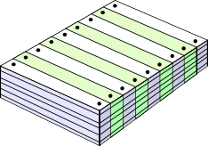



Configuration Management
Introduction
The First Law: No matter where you are in the system lifecycle, the system will change and the desire to change it will persist throughout the lifecycle.
What are these changes?
business requirements
technical requirements user requirements

Slide 98









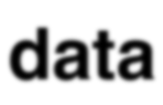
Configuration Management
Software Configuration

Slide 99
Configuration Management
Baselines
The IEEE(IEEE Std. No. 610.12-1990) defines a baseline as:
A specification or product that has been formally reviewed and agreed upon, that thereafter serves as the basis for further development, and that can be changed only through formal change control procedures.
A baseline is a milestone in the development of software that is marked by the delivery of one or more software configuration items and the approval of these SCIs that is obtained through a formal technical review.

Slide 100

Configuration Management
Baselines
modified
SCIs
Project database
approved
Software engineering tasks
Formal technical reviews
SCIs
SCIs
stored
SCIs
extracted
SCM
controls
SCIs
BASELINES:
System Specification Software Requirements Design Specification Source Code
Test Plans/Procedures/Data
Operational System

Slide 101
Configuration Management
Software Configuration Objects
Data model
Design specification
data design architectural design module design interface design
Component N
interface description algorithm description PDL
Test specification
test plan
test procedure test cases
Source code

Slide 102
Configuration Management
SCM Repository
The SCM repository is the set of mechanisms and data structures that allow a software team to manage change in an effective manner.
The repository performs or precipitates the following functions:
Data integrity
Information sharing
Tool integration
Data integration
Methodology enforcement
Document standardization
Repository Content

Slide 103
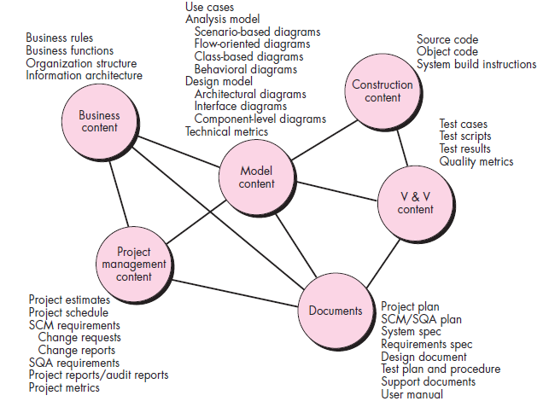
Configuration Management
Repository Content

Slide 104
Configuration Management
Repository Features
Versioning
Saves all of these versions to enable effective management of product releases and to permit developers to go back to previous versions.
Dependency tracking and change management
The repository manages a wide variety of relationships among the data elements stored in it.
Requirements tracing
Provides the ability to track all the design and construction components and deliverables that result from a specific requirement specification
Configuration management
Keeps track of a series of configurations representing specific project milestones or production releases.
Version management provides the needed versions and link management keeps track of interdependencies.
Audit trails
Establishes additional information about when, why and by whom changes are made.

Slide 105
Configuration Management
SCM Elements
Component elements—a set of tools coupled within a file management system (e.g., a database) that enables access to and management of each software configuration item.
Process elements—a collection of procedures and tasks that define an effective approach to change management (and related activities) for all constituencies involved in the management, engineering and use of computer software.
Construction elements—a set of tools that automate the construction of software by ensuring that the proper set of validated components (i.e., the correct version) have been assembled.
Human elements—to implement effective SCM, the software team uses a set of tools and process features (encompassing other CM elements).

Slide 106
Configuration Management
SCM Process - Addresses the following questions…
How does a software team identify the discrete elements of a software configuration?
How does an organization manage the many existing versions of a program (and its documentation) in a manner that will enable change to be accommodated efficiently?
How does an organization control changes before and after software is released to a customer?
Who has responsibility for approving and ranking changes?
How can we ensure that changes have been made properly?
What mechanism is used to appraise others of changes that are made?

Slide 107
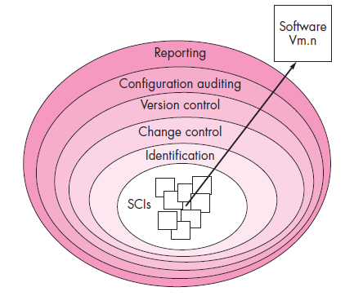
Configuration Management
SCM Process

Slide 108
Configuration Management
Version Control
Version control combines procedures and tools to manage different versions of configuration objects that are created during the software process.
A version control system implements or is directly integrated with four major capabilities:
A Project database (repository) that stores all relevant configuration objects.
A Version management capability that stores all versions of a configuration object (or enables any version to be constructed using differences from past versions);
A Make facility that enables the software engineer to collect all relevant configuration objects and construct a specific version of the software.
An Issues tracking (also called bug tracking) capability that enables the team to record and track the status of all outstanding issues associated with each configuration object.

Slide 109


Configuration Management
Change Control
The reality of change control in a modern software engineering context has been summed up beautifully by James Bach.
Change control is vital. But the forces that make it necessary also make it annoying.
Bach recognizes that we face a balancing act. Too much change control and we create problems. Too little, and we create other problems.
The change control process is illustrated schematically in below figure.

Slide 110
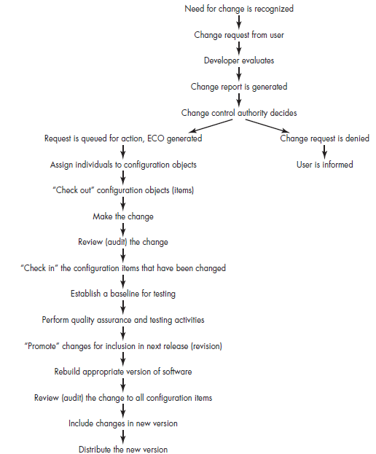
Configuration Management
Change Control Process

Slide 111
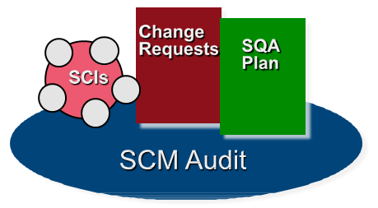
Configuration Management
Auditing
Identification, version control and change control help you to maintain order in what would otherwise be a chaotic and fluid situation.
How can a software team ensure that the change has been properly implemented? The answer is twofold: (1) Technical reviews, (2) Software configuration audit
The technical review focuses on the technical correctness of the configuration object that has been modified.
A software configuration audit complements the technical review by assessing a configuration object for characteristics that are generally not considered during review.

Slide 112
Configuration Management
Auditing
The review asks and answers the following questions:
1. Has the change specified in the ECO (Engineering Change Order) been made? Have any additional modifications been incorporated?
2. Has a technical review been conducted to assess technical correctness?
3. Has the software process been followed and have software engineering standards been properly applied?
4. Has the change been "highlighted" in the SCI? Have the change date and change author been specified? Do the attributes of the configuration object reflect the change?
5. Have SCM procedures for noting the change, recording it and reporting it been followed?
6. Have all related SCIs been properly updated?

Slide 113
Configuration Management
Status Accounting
Configuration status reporting (sometimes called status accounting) is an SCM task that answers the following questions:
(1) What happened?
(2) Who did it?
(3) When did it happen?
(4) What else will be affected?
The flow of information for configuration status reporting (CSR) is illustrated in figure - The Change control process.
Each time an SCI is assigned new or updated identification, a CSR entry is made.
Each time a change is approved by the CCA (i.e., an ECO is issued), a CSR entry is made. (Change Control Authority)
Each time a configuration audit is conducted, the results are reported as part of the CSR task.
Output from CSR may be placed in an online database or website, so that software developers or support staff can access change information by keyword category.
In addition, a CSR report is generated on a regular basis and is intended to keep management and practitioners appraised of important changes.

Slide 114










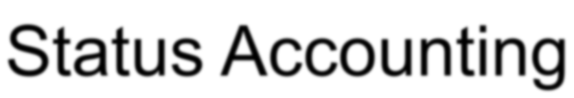



Configuration Management
Status Accounting

Slide 115
Configuration Management
SCM for Web Engineering
Content
- A typical WebApp contains a vast array of content—text, graphics, applets, scripts, audio/video files, forms, active page elements, tables, streaming data, and many others.
- The challenge is to organize this sea of content into a rational set of configuration objects and then establish appropriate configuration control mechanisms for these objects.
People
Because a significant percentage of WebApp development continues to be conducted in an ad hoc manner, any person involved in the WebApp can (and often does) create content.
Scalability
As size and complexity grow, small changes can have far-reaching and unintended affects that can be problematic.
Therefore, the rigor of configuration control mechanisms should be directly proportional to application scale.

Slide 116
Configuration Management
SCM for Web Engineering
Politics
Who owns a WebApp?
Who assumes responsibility for the accuracy of the information on the website?
Who assures that quality control processes have been followed before information is published to the site?
Who is responsible for making changes?
Who assumes the cost of change?

Slide 117
Configuration Management
Content Management
The collection subsystem encompasses all actions required to create and/or acquire content and the technical functions that are necessary to
Convert content into a form that can be represented by a mark-up
language (e.g., HTML, XML)
Organize content into packets that can be displayed effectively on the
client-side.
The management subsystem implements a repository that encompasses the following elements:
Content database – the information structure that has been established
to store all content objects.
Database capabilities—functions that enable the CMS to search for specific content objects (or categories of objects), store and retrieve objects and manage the file structure that has been established for the content.
Configuration management functions—the functional elements and associated workflow that support content object identification, version control, change management, change auditing and reporting.

Slide 118
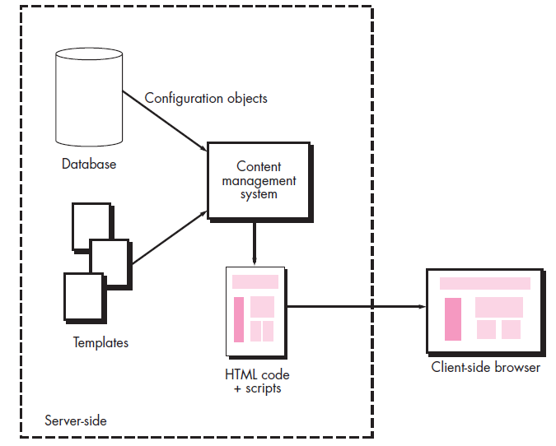
Configuration Management
Content Management

Slide 119
Configuration Management
Content Management
The publishing subsystem extracts from the repository, converts it to a form that is amenable to publication and formats it so that it can be transmitted to client-side browsers.
The publishing subsystem accomplishes these tasks using a series of templates.
Each template is a function that builds a publication using one of three different components
Static elements—Text, graphics, media and scripts that require
no further processing are transmitted directly to the client-side
Publication services—Function calls to specific retrieval and formatting services that personalize content (using predefined rules), perform data conversion, and build appropriate navigation links.
External services—Provide access to external corporate information infrastructure such as enterprise data or “back- room” applications.

Slide 120
Configuration Management
Change Management for WebApps
The workflow associated with change control for conventional software is generally too ponderous for WebApp development.
It is unlikely that the change request, change report, and engineering change
order sequence can be achieved in an agile manner that is acceptable
for most WebApp development projects.
To implement effective change management within the "code and go" philosophy that continues to dominate WebApp development, the conventional change control process must be modified.

Slide 121
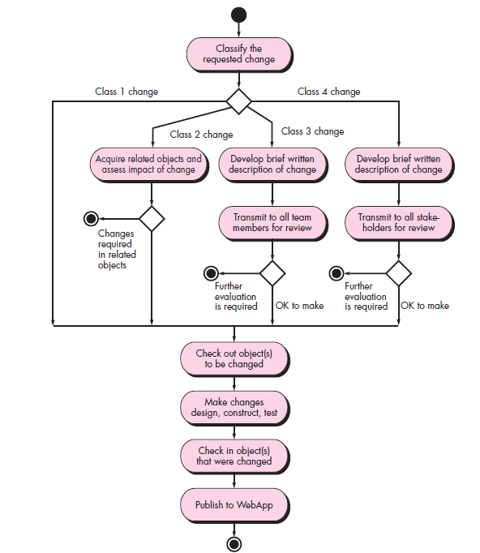
Configuration Management
Change Management for WebApp

Slide 122
Configuration Management
Change Management for WebApps
Each change should be categorized into one of four classes:
1. Class 1 - A content or function change that corrects an error or enhances local content or functionality
2. Class 2 - A content or function change that has an impact on other content objects or functional components
3. Class 3 - A content or function change that has a broad impact across a WebApp (e.g., major extension of functionality, significant enhancement or reduction in content, major required changes in navigation)
4. Class 4 - A major design change (e.g., a change in interface design or navigation approach) that will be immediately noticeable to one or more categories of user.
Once the requested change has been categorized, it can be processed according to the algorithm shown in above figure - Managing changes for WebApps

Slide 123
Project Planning
WBC
Scheduling of a software project does not differ greatly from scheduling of any multitask engineering effort.
Therefore, generalized project scheduling tools and techniques can be applied with little modification for software projects.
Program Evaluation and Review Technique (PERT) and the Critical Path Method (CPM) are two project scheduling methods that can be applied to software development.
Both techniques are driven by information already developed in earlier project planning activities: estimates of effort, a decomposition of the product function, the selection of the appropriate process model and task set and decomposition of the tasks that are selected.
Interdependencies among tasks may be defined using a task network. Tasks, sometimes called the project work breakdown structure (WBS) are defined for the product as a whole or for individual functions.
Both PERT and CPM provide quantitative tools that allow you to (1) determine the critical path - the chain of tasks that determines the duration of the project, (2) establish "most likely" time estimates for individual tasks by applying statistical methods, and (3) calculate "boundary times" that define a time "window" for a particular task.

Slide 124
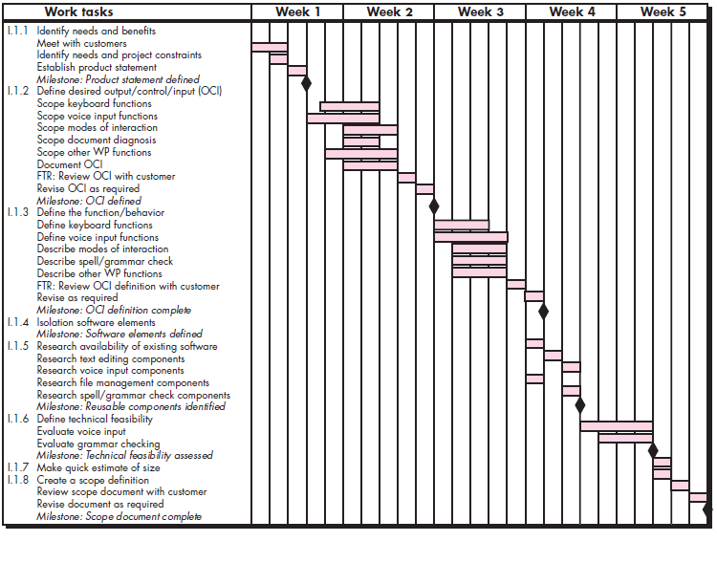
Project Planning
An example time-line chart

Slide 125
Project Planning
WBC - Time-Line Charts
When creating a software project schedule, you begin with a set of tasks (the work breakdown structure).
If automated tools are used, the work breakdown is input as a task network or task outline.
Effort, duration and start date are then input for each task.
In addition, tasks may be assigned to specific individuals.
As a consequence of this input, a time-line chart, also called a Gantt chart, is generated.
A time-line chart can be developed for the entire project.
Alternatively, separate charts can be developed for each project function or for each individual working on the project.
Figure - An example time-line chart illustrates the format of a time-line chart.
It depicts a part of a software project schedule that emphasizes the concept scoping task for a word-processing (WP) software product.

Slide 126
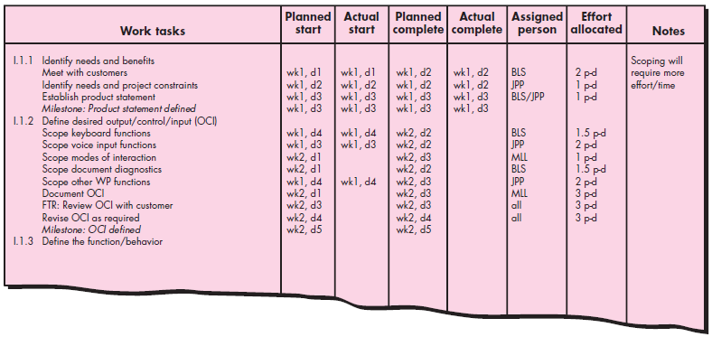
Project Planning
An example project table

Slide 127
Project Planning
WBC - Time-Line Charts
All project tasks (for concept scoping) are listed in the left-hand column.
The horizontal bars indicate the duration of each task.
When multiple bars occur at the same time on the calendar, task concurrency is implied.
The diamonds indicate milestones.
Once the information necessary for the generation of a time-line chart has been input, the majority of software project scheduling tools produce project tables - a tabular listing of all project tasks, their planned and actual start and end dates, and a variety of related information (Figure - An example project table).
Used in conjunction with the time-line chart, project tables enable you to track progress.

Slide 128
Project Planning
Why are Projects Late?
An unrealistic deadline established by someone outside the software development group.
Changing customer requirements that are not reflected in schedule changes;
An honest underestimate of the amount of effort and/or the number of resources that will be required to do the job;
Predictable and/or unpredictable risks that were not considered when the project commenced;
Technical difficulties that could not have been foreseen in advance;
Human difficulties that could not have been foreseen in advance;
Miscommunication among project staff that results in delays;
A failure by project management to recognize that the project is falling behind schedule and a lack of action to correct the problem.

Slide 129
Project Planning
Scheduling Principles
Compartmentalization—Define distinct tasks
Interdependency—Indicate task interrelationship
Effort validation—Be sure resources are available
Defined responsibilities—People must be assigned
Defined outcomes—Each task must have an output
Defined milestones—Review for quality

Slide 130
Project Planning
Effort and Delivery Time

Slide 131
Project Planning
Effort Allocation
“Front end” activities
Customer communication
Analysis
Design
Review and modification
Construction activities
Coding or code generation
Testing and installation
Unit, integration
White-box, black box
Regression
40-50%
15-20%
30-40%

Slide 132
Project Planning
The overall goal of project planning is to establish a pragmatic strategy for controlling, tracking and monitoring a complex technical project.
Why? So the end result gets done on time, with quality!
Project Planning Task Set – I
Establish project scope
Determine feasibility
Analyze risks
Define required resources
Determine require human resources
Define reusable software resources
Identify environmental resources

Slide 133
Project Planning
Project Planning Task Set – II
Estimate cost and effort
Decompose the problem
Develop two or more estimates using size, function points, process tasks or use-cases
Reconcile the estimates
Develop a project schedule
Scheduling
Establish a meaningful task set
Define a task network
Use scheduling tools to develop a timeline chart
Define schedule tracking mechanisms

Slide 134
Project Planning
Defining Task Sets
Determine type of project
Assess the degree of rigor required
Identify adaptation criteria
Select appropriate software engineering tasks

Slide 135
Project Planning
Task Set Refinement
1.1 Concept scoping determines the overall scope of the project.
Task definition: Task 1.1 Concept Scoping
1.1.1 Identify need, benefits and potential customers;
1.1.2 Define desired output/control and input events that drive the application;
Begin Task 1.1.2
1.1.2.1 FTR: Review written description of need
FTR indicates that a formal technical review is to be conducted.
1.1.2.2 Derive a list of customer visible outputs/inputs
1.1.2.3 FTR: Review outputs/inputs with customer and revise as required;
endtask Task 1.1.2
1.1.3 Define the functionality/behavior for each major function;
Begin Task 1.1.3
1.1.3.1 FTR: Review output and input data objects derived in task 1.1.2;
1.1.3.2 Derive a model of functions/behaviors;
1.1.3.3 FTR: Review functions/behaviors with customer and revise as required;
endtask Task 1.1.3
1.1.4 Isolate those elements of the technology to be implemented in software;
1.1.5 Research availability of existing software;
1.1.6 Define technical feasibility;
1.1.7 Make quick estimate of size;
1.1.8 Create a Scope Definition;
endTask definition: Task 1.1
is refined to

Slide 136
Project Planning
Define a Task Network

Slide 137
Estimation
Estimation of resources, cost, and schedule for a software engineering effort requires
Experience
Access to good historical information (metrics)
The courage to commit to quantitative predictions when qualitative information is all that exists
Estimation carries inherent risk and this risk leads to uncertainty
Write it Down!
Project Scope
Estimates
Risks
Schedule
Control strategy
Software
Project
Plan

Slide 138
Scope
What is Scope?
Software scope describes
The functions and features that are to be delivered to end-users
The data that are input and output
The “content” that is presented to users as a consequence of using the software
The performance, constraints, interfaces, and reliability that bound the system.
Scope is defined using one of two techniques:
A narrative description of software scope is developed after communication with all stakeholders.
A set of use-cases is developed by end-users.
To Understand Scope…
- Understand the customers needs
- Understand the business context
- Understand the project boundaries
- Understand the customer’s motivation
- Understand the likely paths for change
- Understand that ...Even when you understand, nothing is guaranteed!

Slide 139
Scope

Slide 140
REFERENCES
Roger S. Pressman, Software Engineering – A Practitioner Approach, 6th ed., McGraw Hill, 2005
Ian Somerville, Software Engineering, 8th ed., Pearson Education, 2010
Kendall & Kendall, System Analysis and Design, 9th ed., Pearson Education, 2014
Education, https://www.slideshare.net/AwaisSiddique8/cocomo-model-1-and-2

Slide 141
THANK YOU

